Slide 1

Boolean
A special “type” with only two values: False and True.
Used to implement the conditions for selection and looping in an algorithm.

Slide 2
Boolean Expressions
...are expressions that can be evaluated to either strictly True or strictly False.

Slide 3
Boolean Operators
...are used in forming Boolean expressions.
...are also known as “logical” operators
and
or
not
Equality (==)
Inequality (!=)
Comparison (<, >, <=, >=)

Slide 4
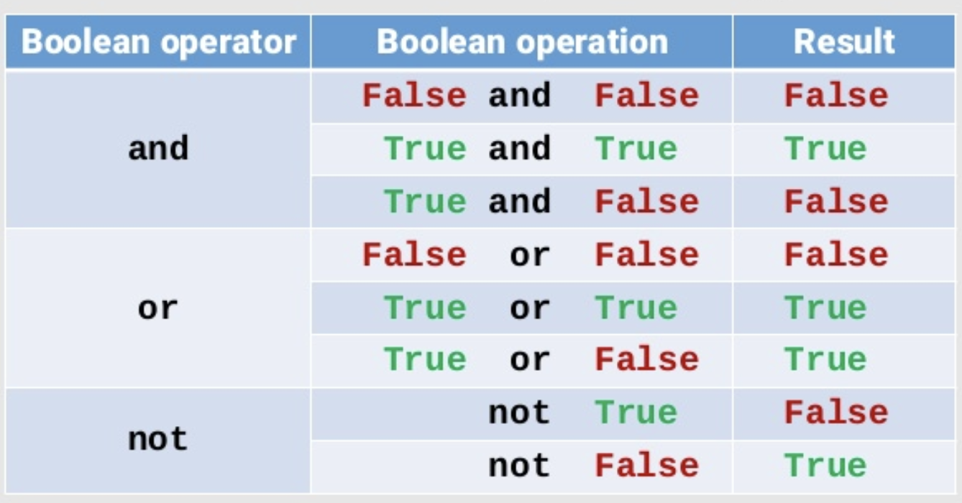

Slide 5
and
True only if both Boolean arguments are true.
Examples:
1<3 and 2>=0
True and False and True
tall and dark and handsome

Slide 6
or
True only if either Boolean argument is true (or both are true).
Examples:
1==2 or 2!=3
True or False or True
good or bad or ugly

Slide 7
not
True only if the single Boolean argument is false.
Examples:
not True
not False
not happy

Slide 8
Equality
True only if both arguments have identical values.
Examples:
1 == 2
1 == 0
42 == 42
truth == beauty

Slide 9
Equality
True only if both arguments have identical values.
Examples:
1 == 2
1 == 0
42 == 42
truth == beauty
not to be confused with assignment (=)

Slide 10
Inequality
True only if arguments have different values.
Examples:
1 != 2
1 != 0
42 != 42
truth != beauty

Slide 11
Comparison
True only if the specified relationship holds
Examples:
1 < 2
0 > 1
42 <= 42
age >= 18

Slide 12
Comparison
True only if the specified relationship holds
Examples:
1 < 2
0 > 1
42 <= 42
age >= 18
Careful!

Slide 13
Precedence
Operator/Convention | Description | Explanation
( ) | Items within parentheses are evaluated first | In (a * (b + c)) - d, the + is evaluated first, then *, then -.
* / % + - | Arithmetic operators (using their precedence rules; see earlier section) | z - 45 * y < 53 evaluates * first, then -, then <.
< <= > >= == != | Relational, (in)equality, and membership operators | x < 2 or x >= 10 is evaluated as (x < 2) or (x >= 10) because < and >= have precedence over or.
not | not (logical NOT) | not x or y is evaluated as (not x) or y
and | Logical AND | x == 5 or y == 10 and z != 10 is evaluated as (x == 5) or ((y == 10) and (z != 10)) because and has precedence over or.
or | Logical OR | x == 7 or x < 2 is evaluated as (x == 7) or (x < 2) because < and == have precedence over or

Slide 14
Membership operators: in/not in
Evaluates to True or False
Used for testing membership
'hello' in ['h','hello', 1]
True
'e' in 'hello'
True
'w' not in 'hello'
True
'w' in 'hello'
False

Slide 15
Evaluate: True or False?
bool() function allows you to evaluate any value, and give you True or False in return
print(bool(”Python"))
True print(bool(23))
True
x=45
print(bool(x))
True

Slide 16
Most Values are True
Almost any value is evaluated to True if it has some sort of content.
Any string is True, except empty strings.
Any number is True, except 0.
Any list, tuple, set, and dictionary are True, except empty ones.
bool("hello") bool(13) bool(["Mon", "Tue"])
bool(-5)
bool(’false’)

Slide 17
Less Values are False
Not many values that evaluates to False, except empty values
(),
[],
{},
"",
0 (zero)
None
False
False examples
bool(False) bool(None) bool(0) bool("") bool(()) bool([]) bool({})

